Slide 1

Ensemble Methods
Mahmoud Gamiel

Slide 2
AGENDA
01
02
03
04
Bias variance trade off
Ensemble concept and methods
Bagging and Boosting
Coding

Slide 3
01
Basie variance trade off
the problems of overfitting and underfitting.

Slide 8
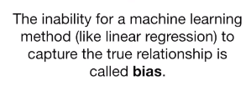

Slide 10
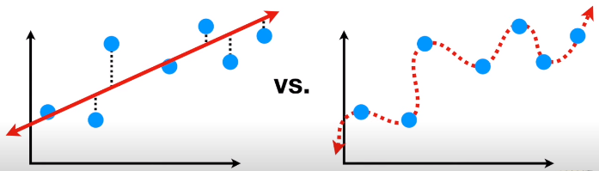

Slide 11
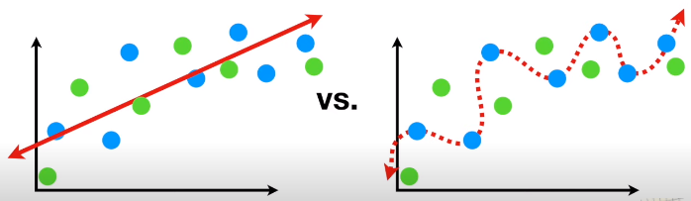

Slide 12
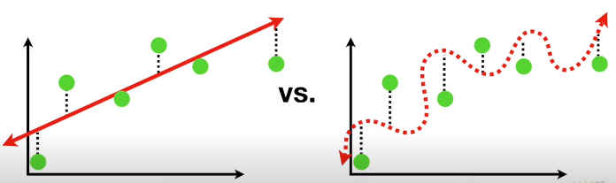

Slide 13
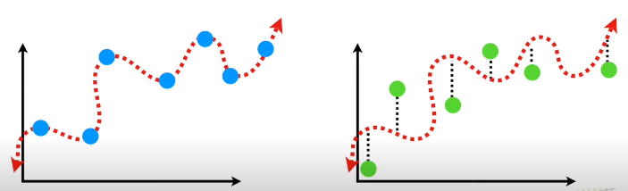
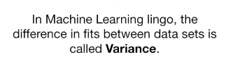

Slide 14
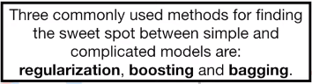
In machine learning , the ideal algorithm has low bias
and can accurately model the true relationship
..and gas low variability, by producing consistent predictions across
Different datasets.

Slide 15
Ensemble Methods
Voting
Bagging
Boosting
Stacking
VS

Slide 16

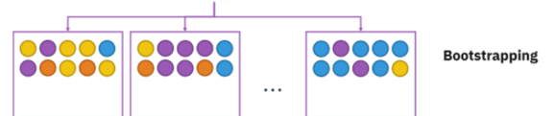

Bagging

Slide 17
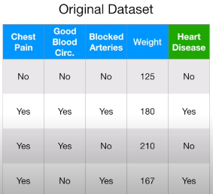
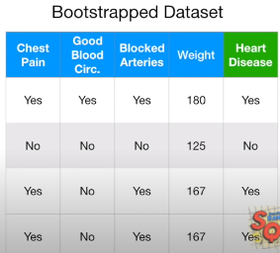
Step 1 : create a “bootstrapped” dataset.

Slide 18
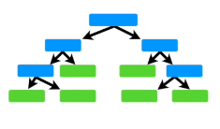
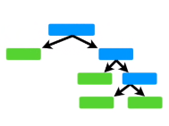
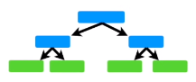
Step 2 : create a decision tree using the bootstrapped dataset ,but only
use a random subset of variables at each step .

Slide 19
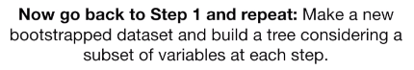

Slide 20
CODING TIME

Slide 21
Boosting

Slide 22


Slide 23


Boosting

Slide 24


Slide 25


Slide 26


Slide 27


Slide 28


Slide 29
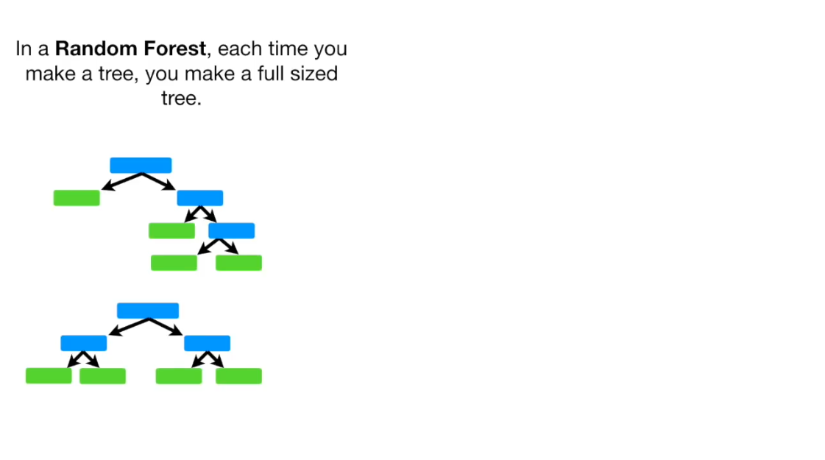

Slide 30
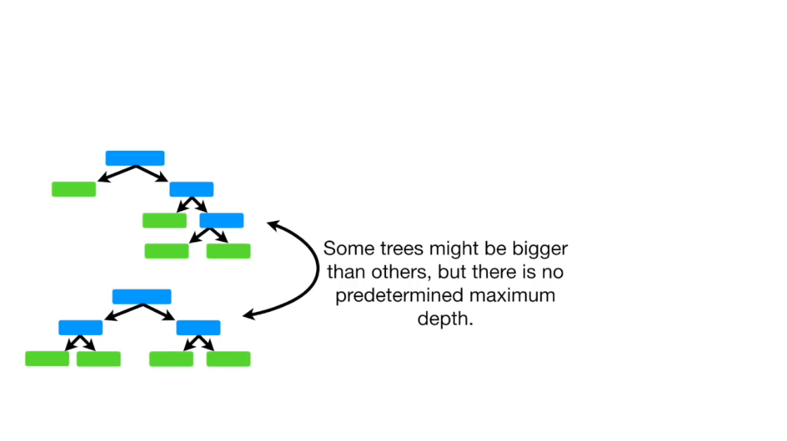

Slide 31
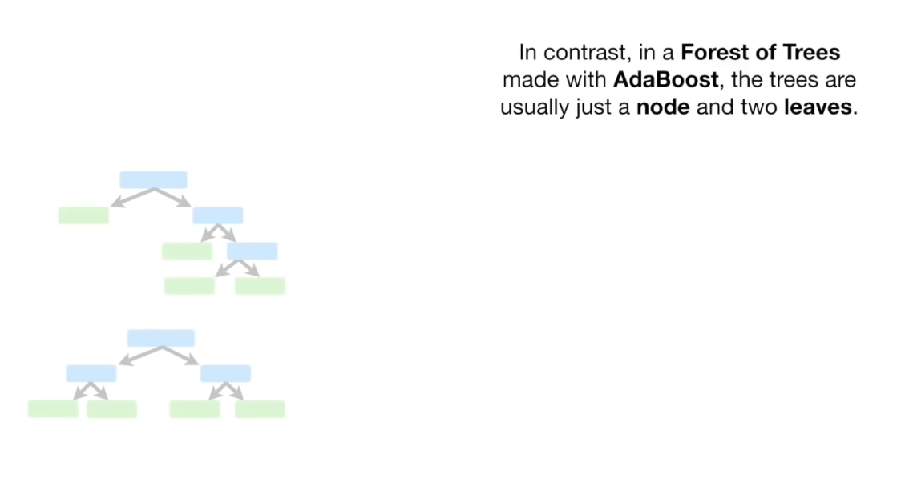

Slide 32
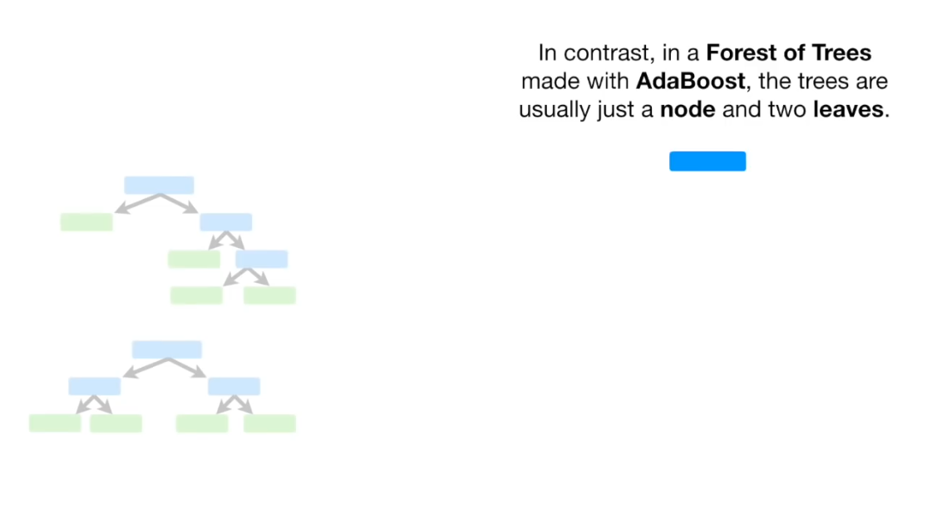

Slide 33
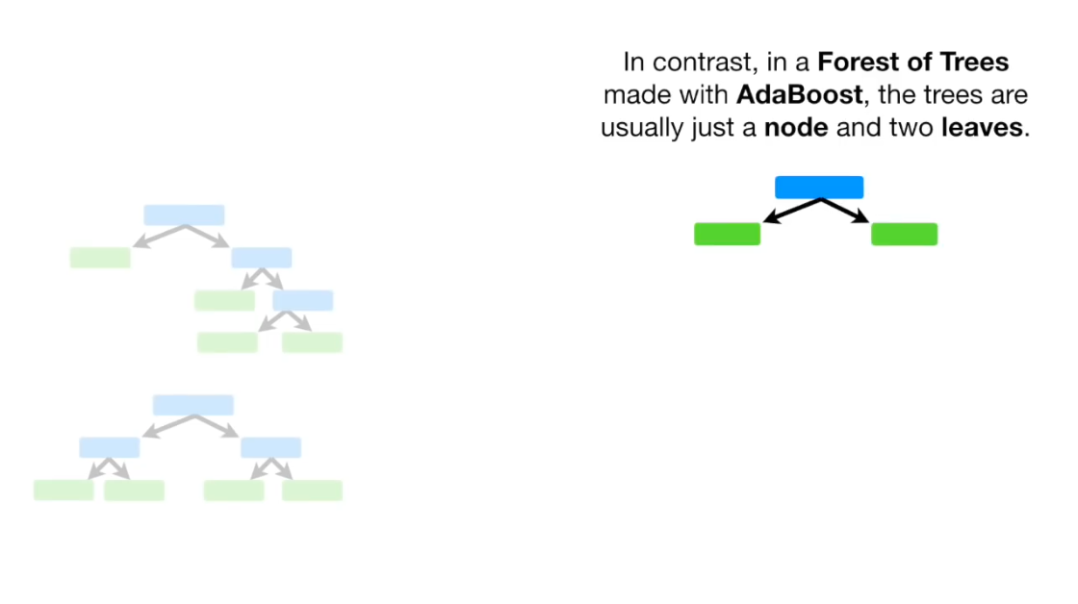

Slide 34
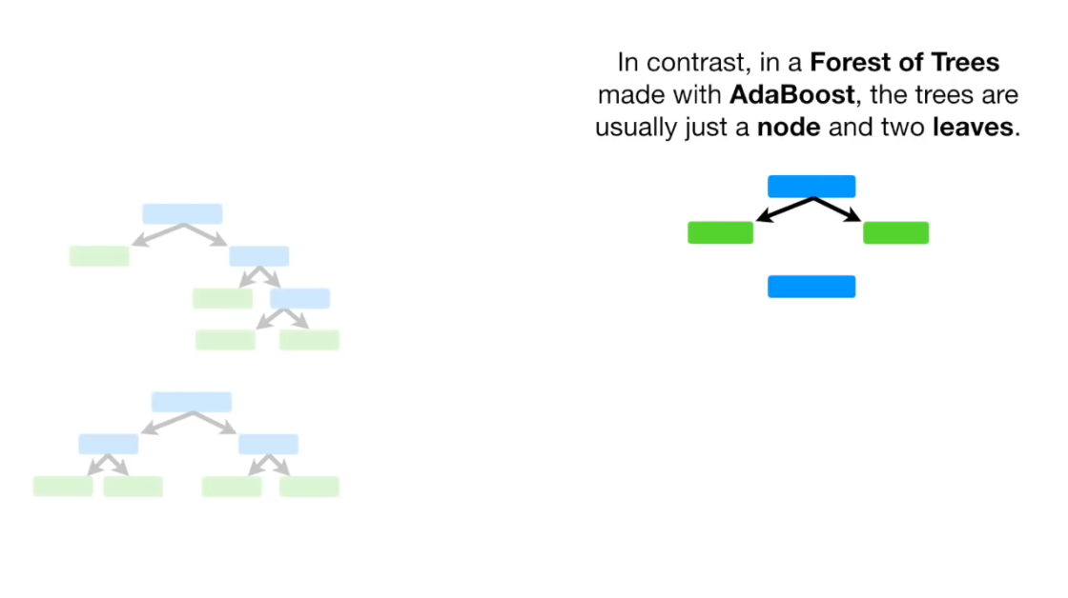

Slide 35
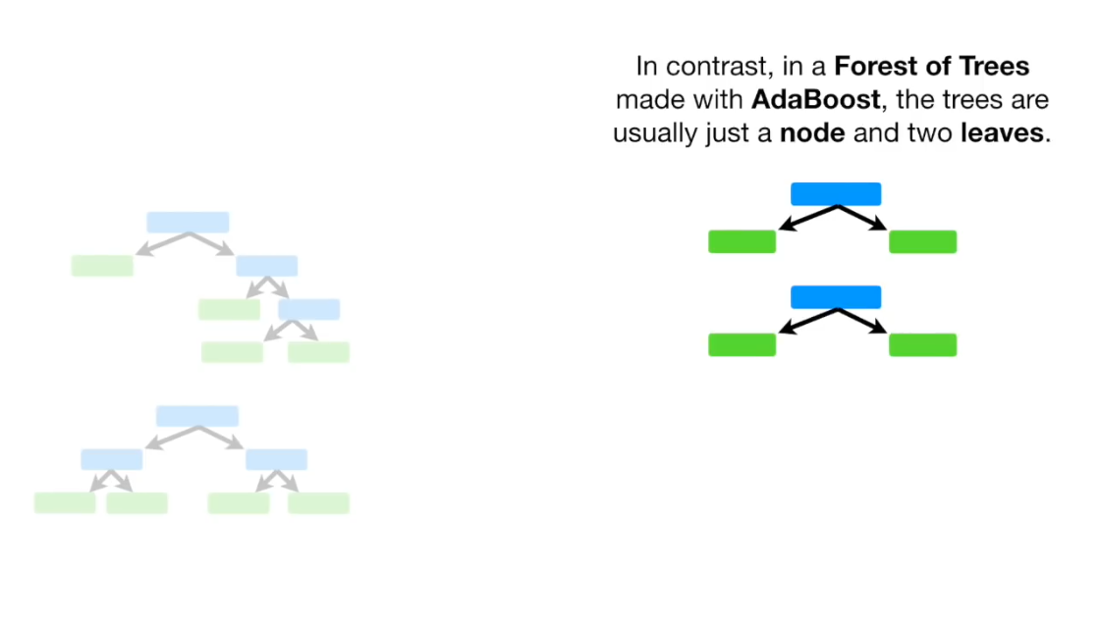

Slide 36
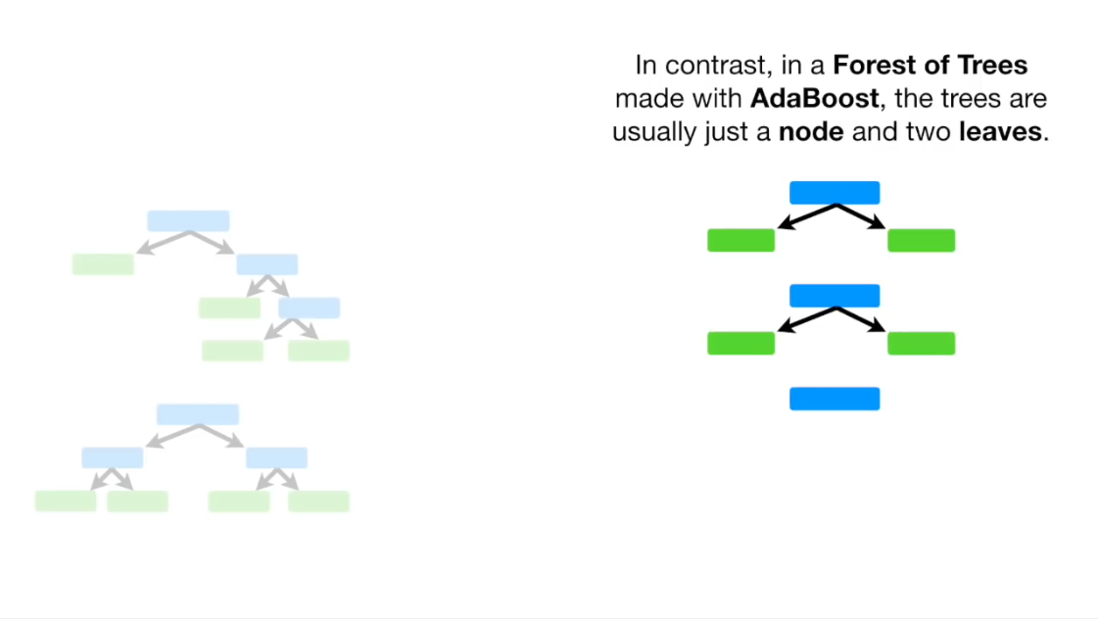

Slide 37
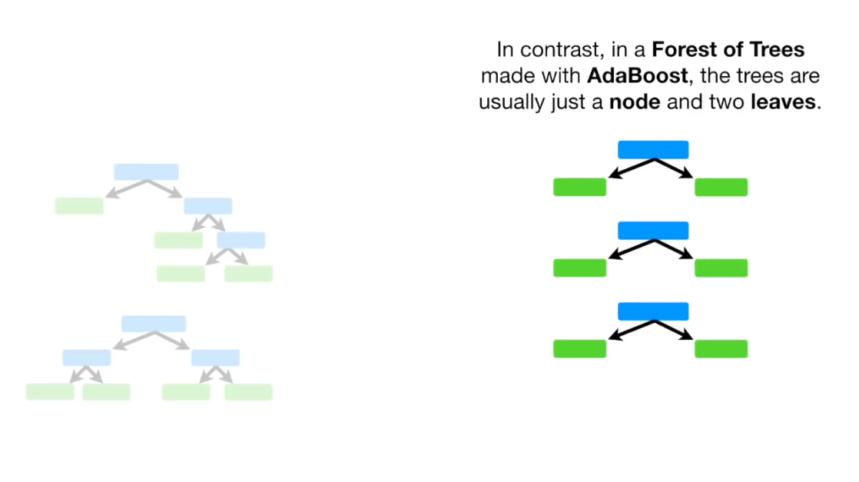

Slide 38
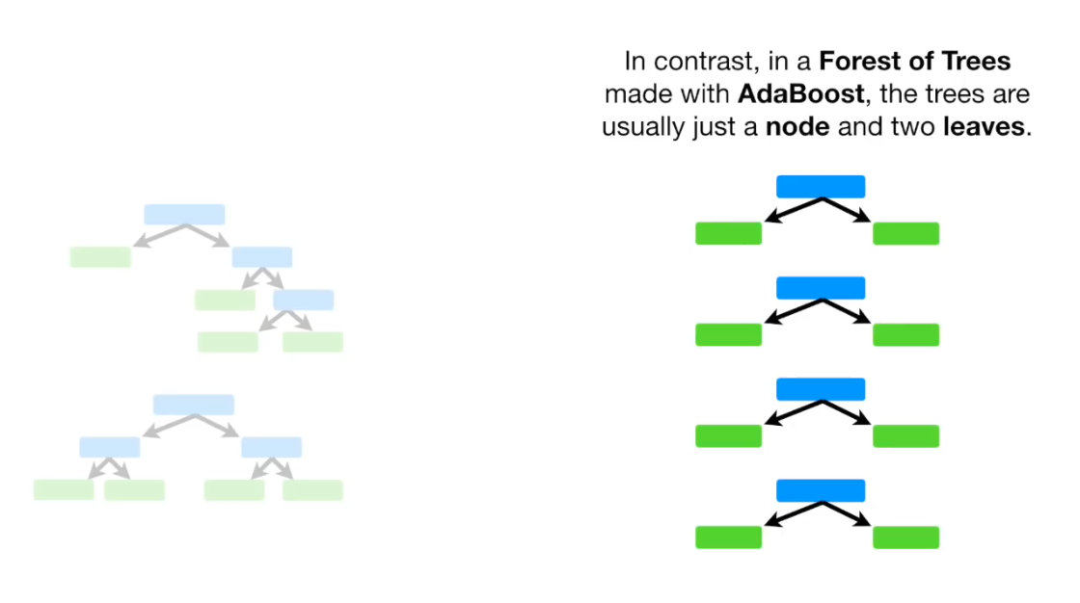

Slide 39
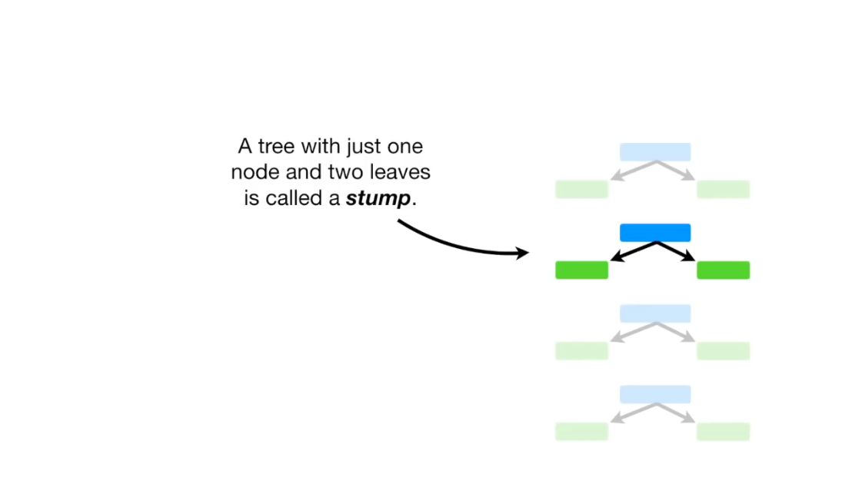

Slide 40
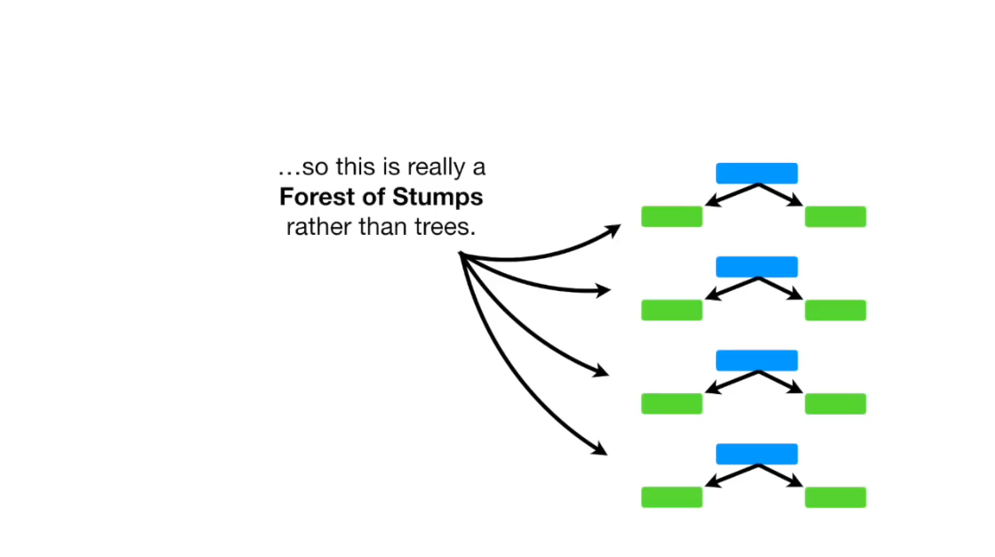

Slide 41
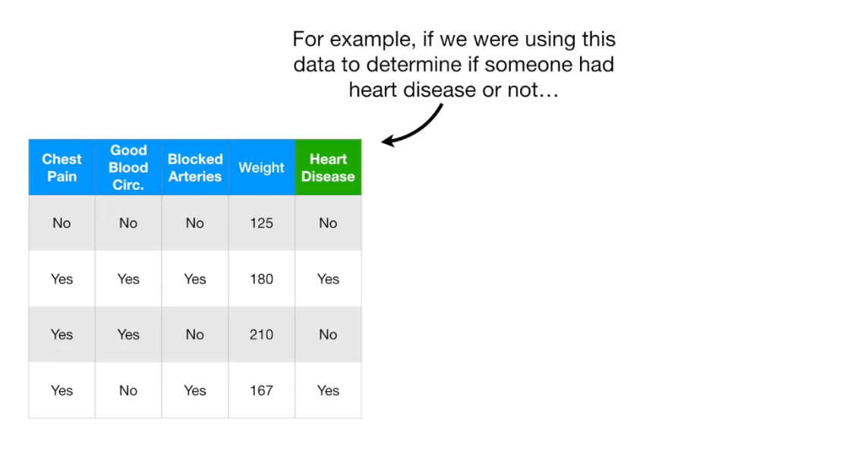

Slide 42
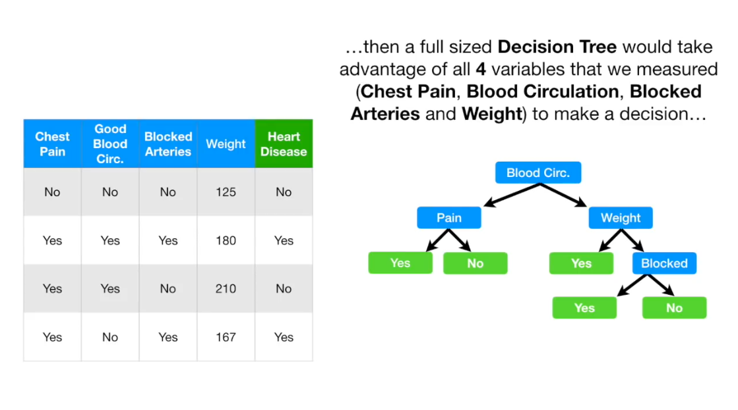

Slide 44
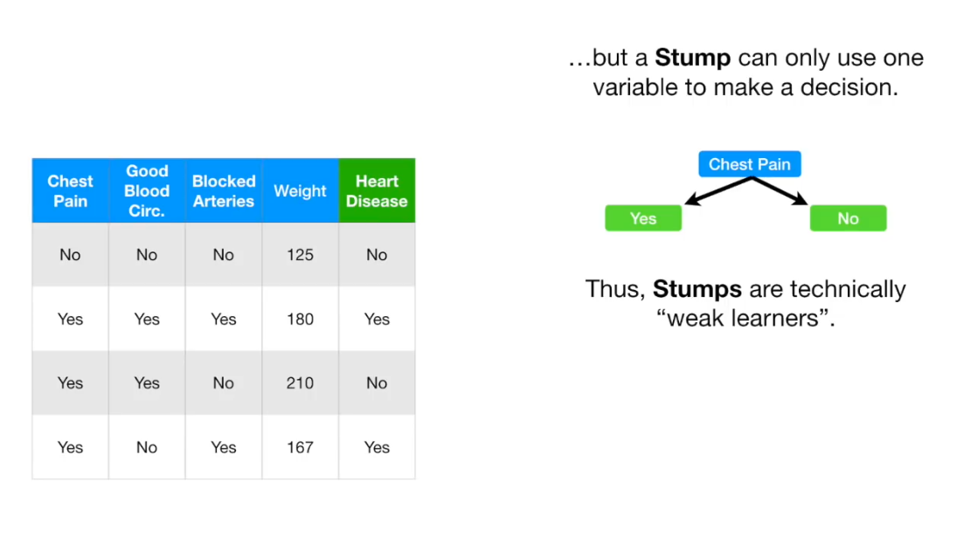

Slide 45


Slide 46


Slide 47
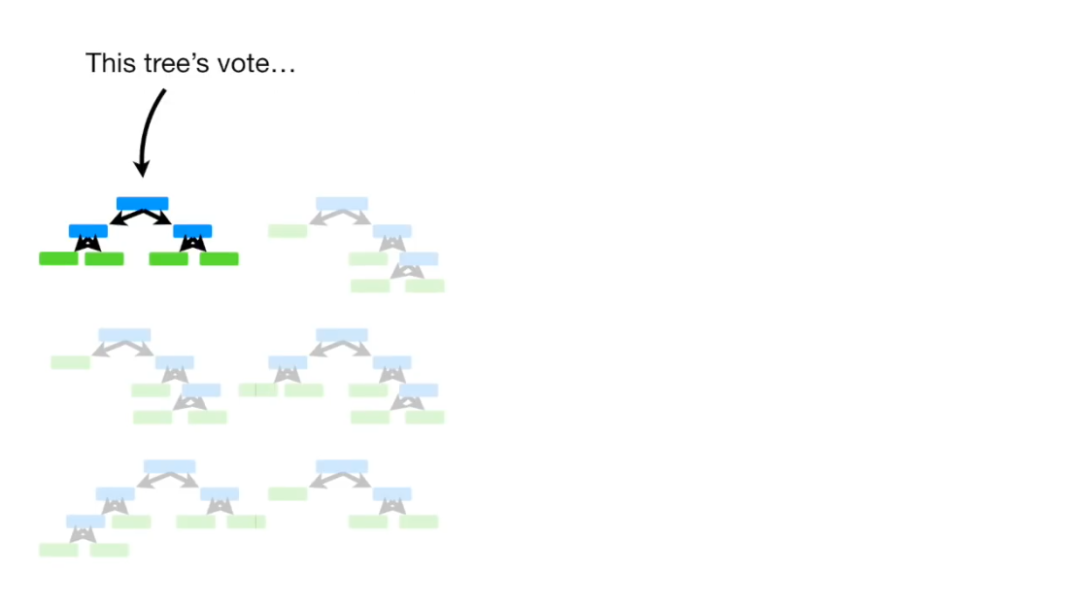

Slide 48
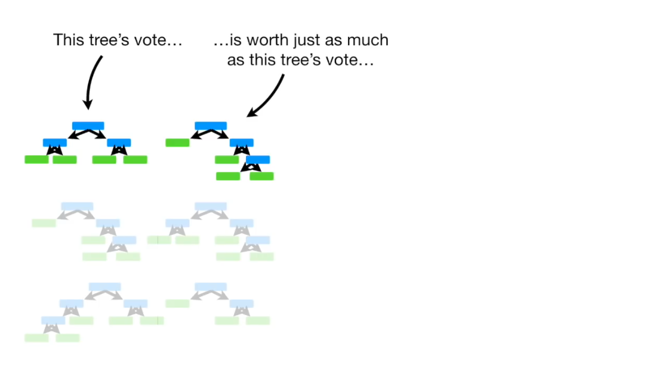

Slide 49
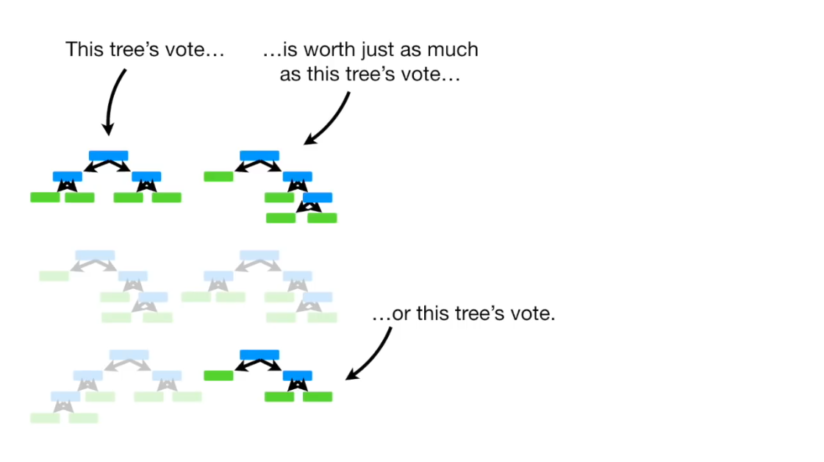

Slide 50
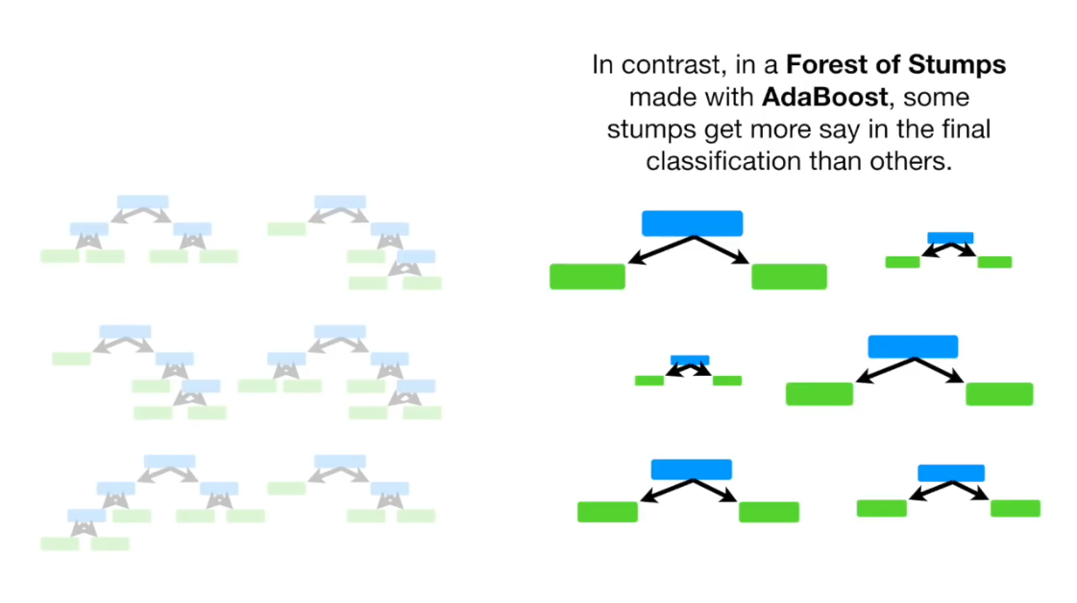

Slide 51
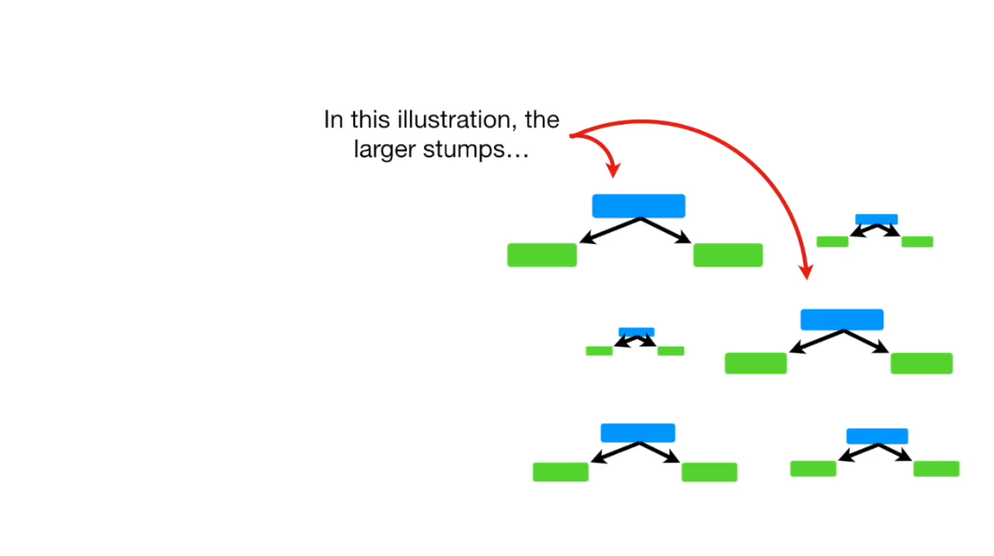

Slide 52
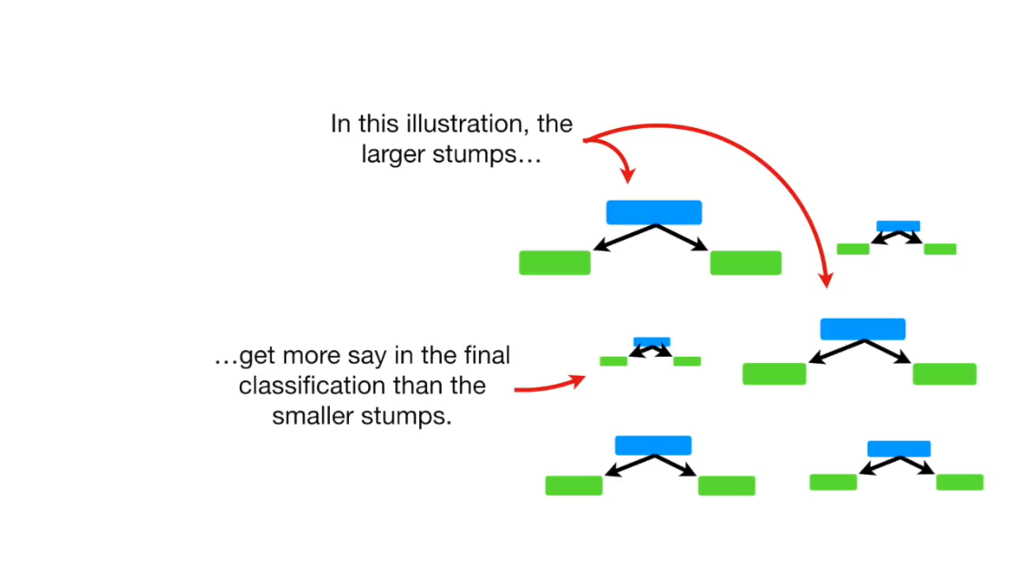

Slide 53
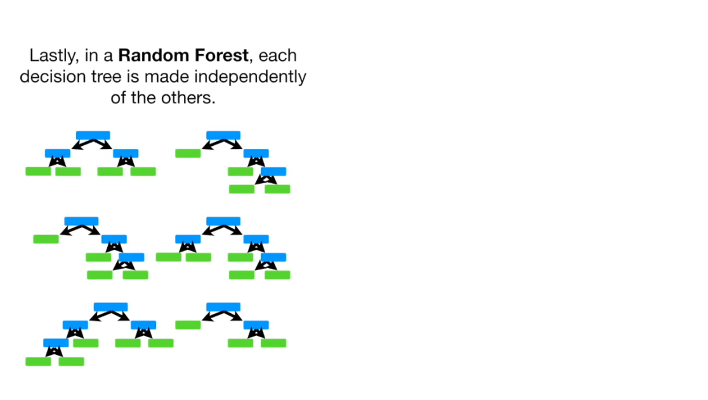

Slide 54
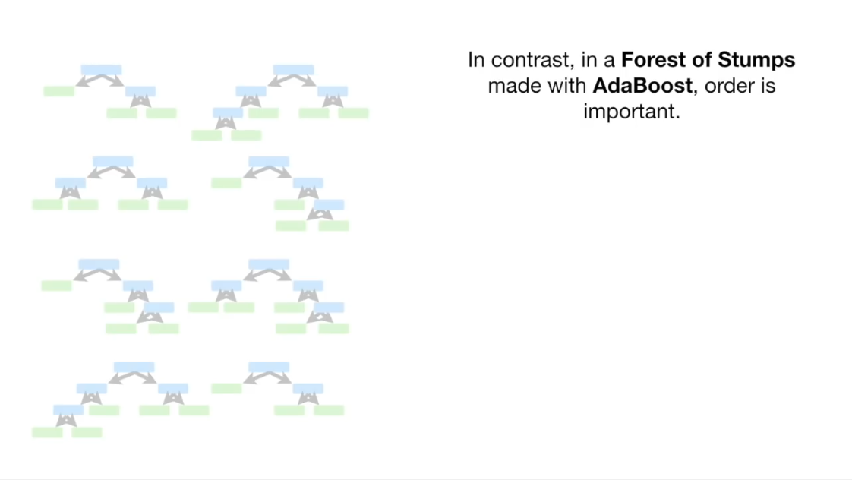

Slide 55
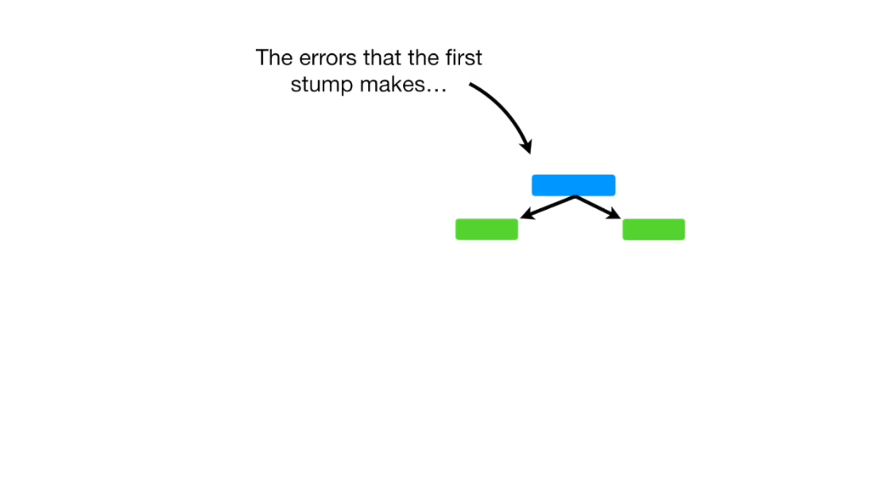

Slide 56
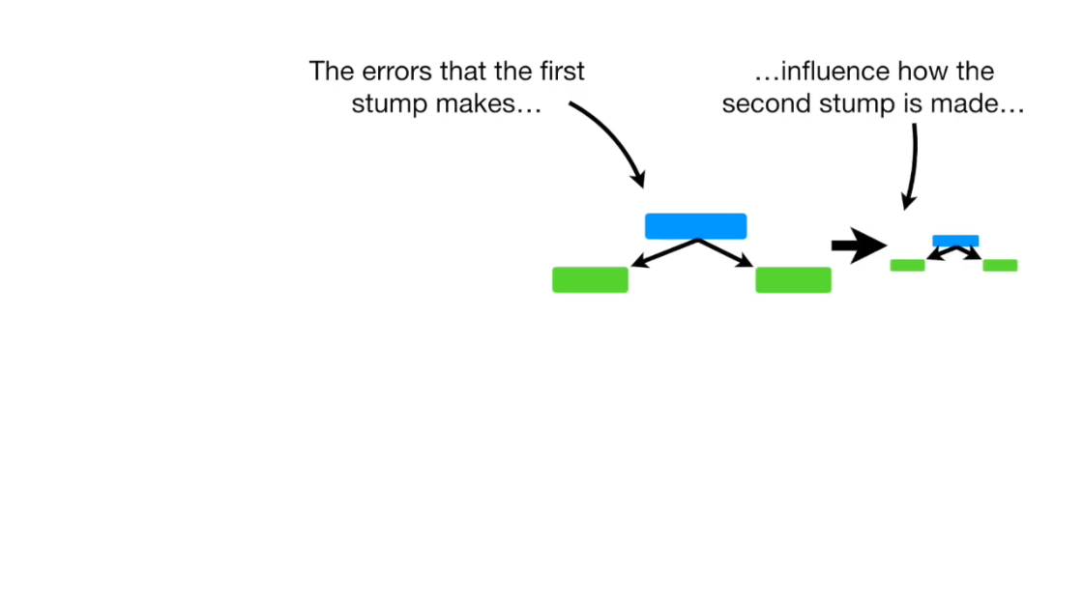

Slide 57
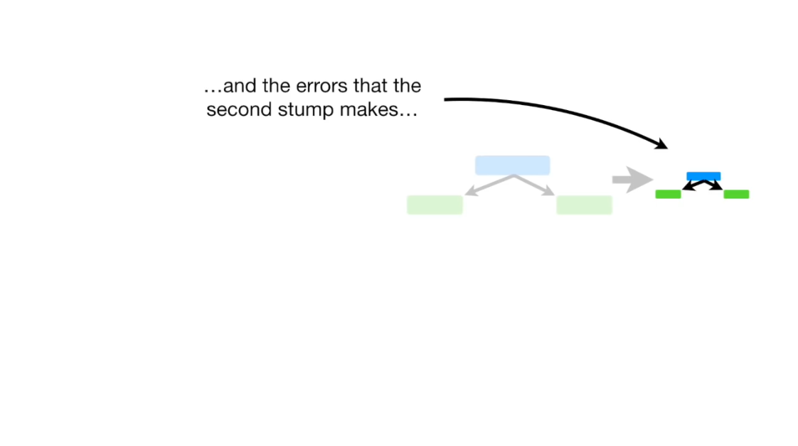

Slide 58
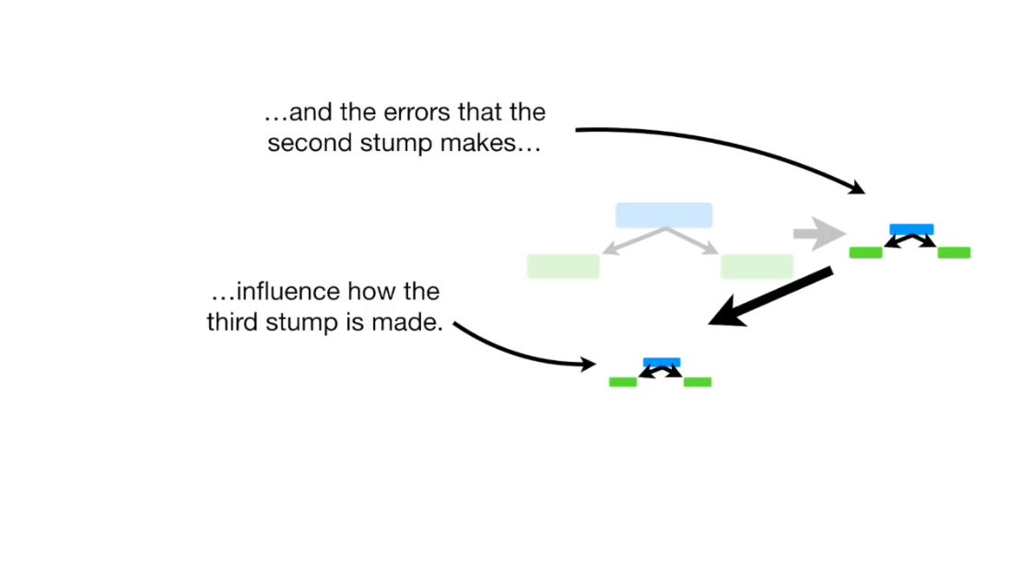

Slide 59
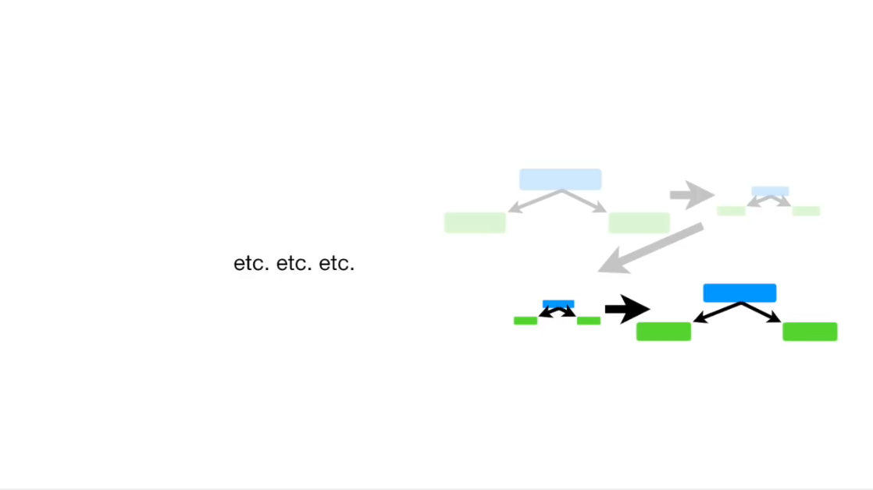

Slide 60
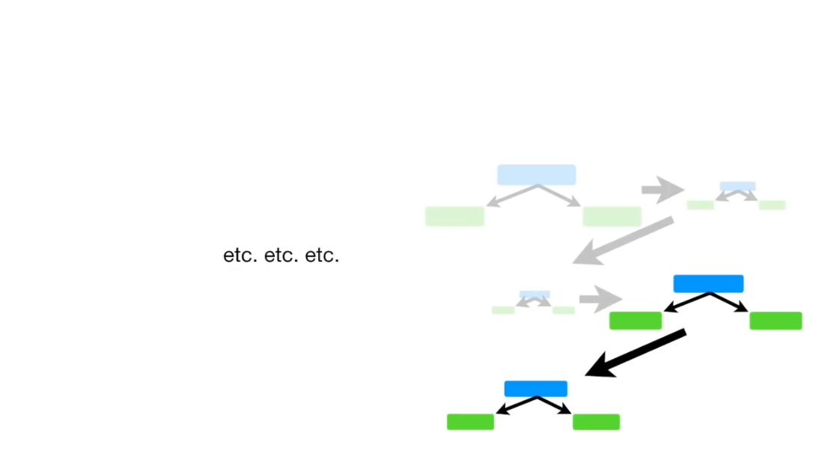

Slide 61
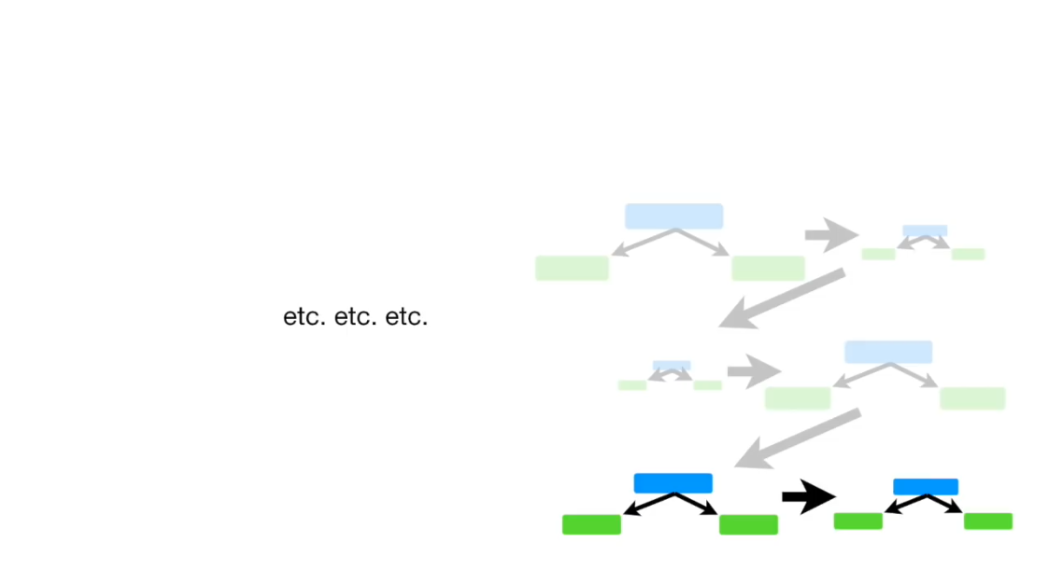

Slide 62
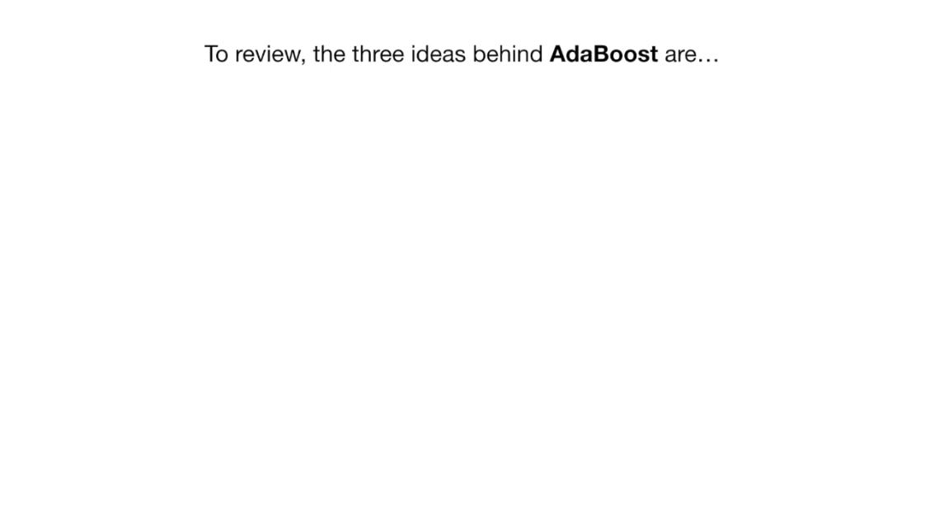

Slide 63
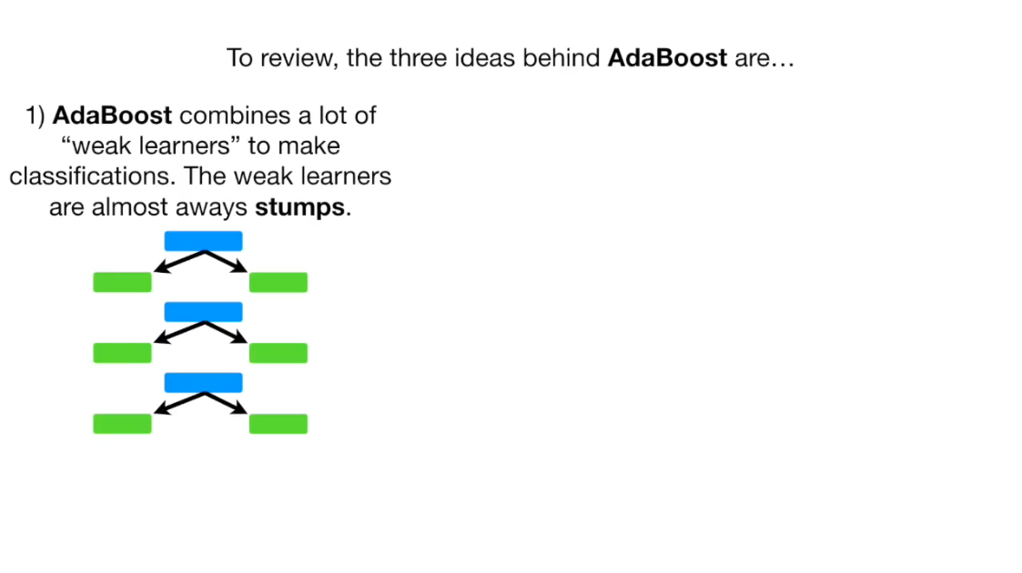

Slide 64
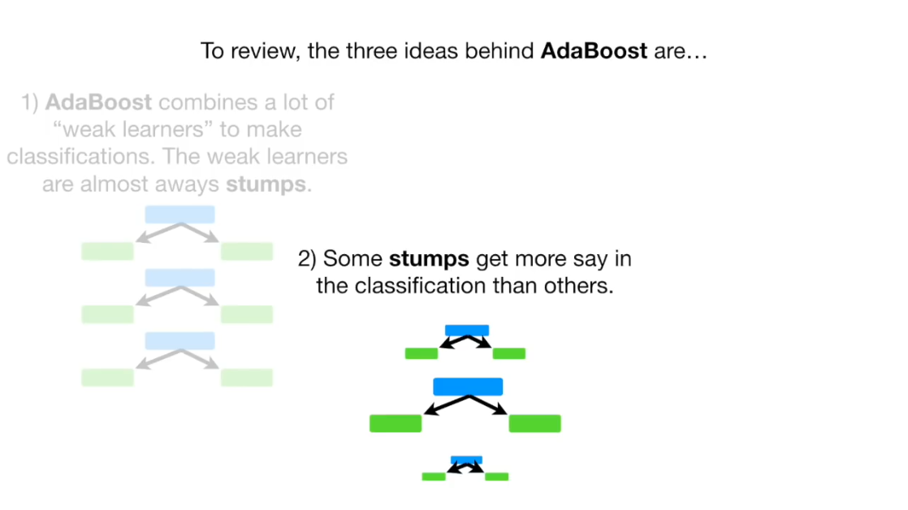

Slide 65
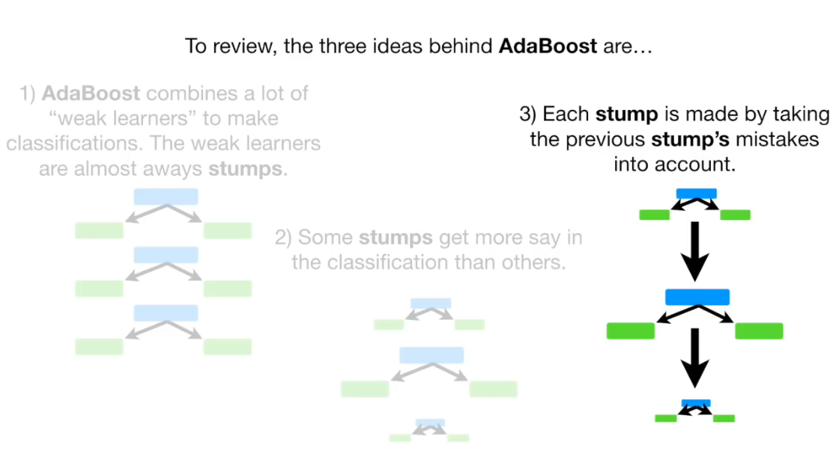

Slide 66
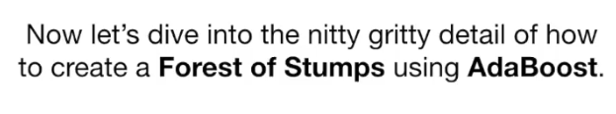

Slide 67
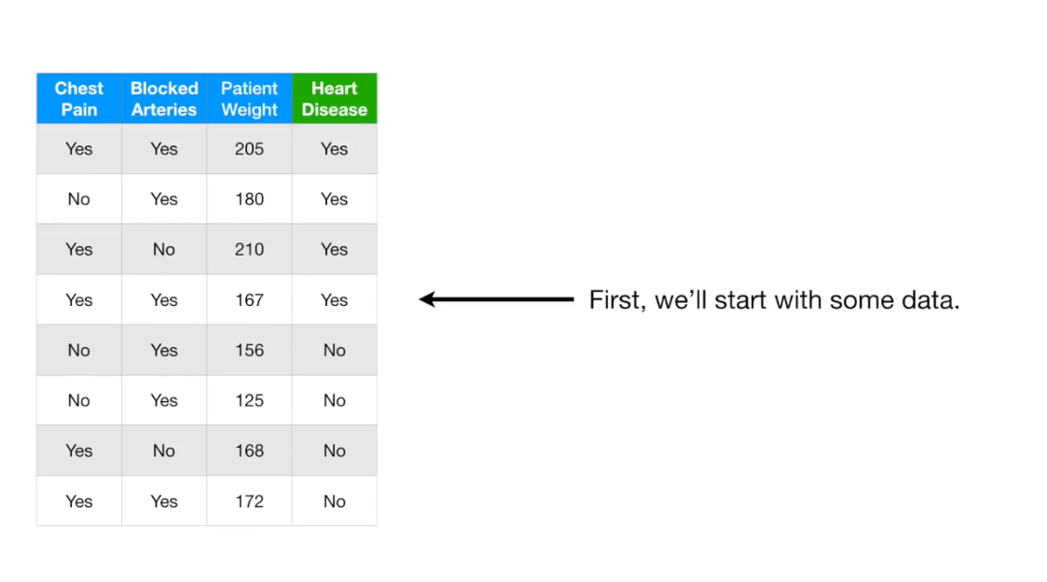

Slide 68


Slide 69


Slide 70


Slide 71


Slide 72


Slide 73


Slide 74


Slide 75


Slide 76




Slide 77


Slide 78




Slide 79



Slide 80


Slide 81


Slide 82



Slide 83


Slide 84



Slide 85



Slide 86


Slide 87


Slide 88


Slide 89


Slide 90


Slide 91


Slide 92


Slide 93


Slide 94


Slide 95


Slide 96


Slide 97


Slide 98


Slide 99


Slide 100


Slide 101


Slide 102


Slide 103


Slide 104


Slide 105


Slide 106


Slide 107


Slide 108


Slide 109


Slide 110


Slide 111


Slide 112


Slide 116
That’s not everything about boosting read more about:
Gradient boost
XGboost
Catboost
lightGBM

Slide 117
CODING TIME

